Slide 1
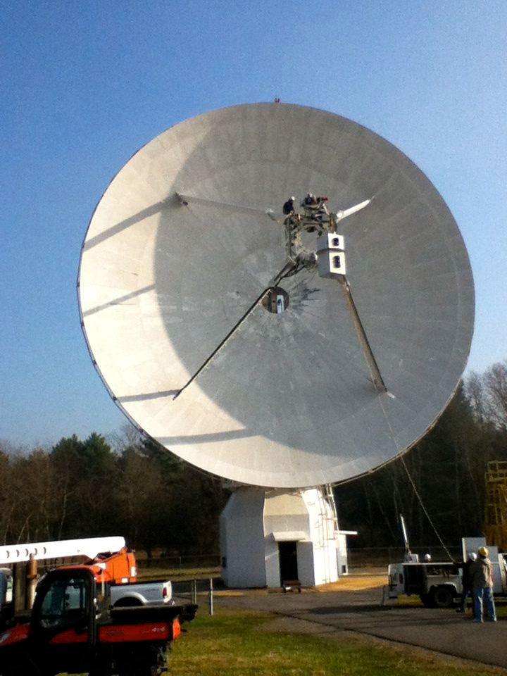
Using a Radio Telescope
Installing the receiver on the 20 Meter Telescope
Notes:
The Skynet 20 Meter Telescope at the NRAO in Green Bank, WV. It is called the 20 Meter Telescope because the dish is 20 meters across.

Slide 2
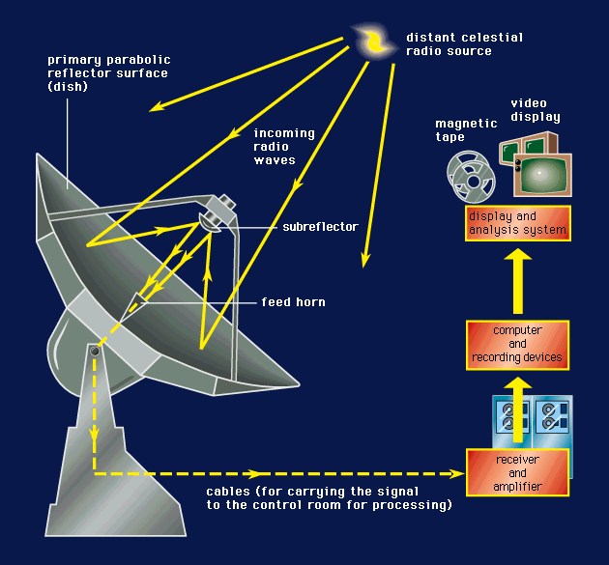
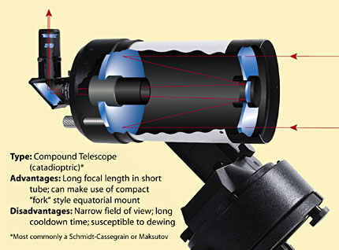
Radio Telescope
Optical Telescope
Notes:
Like an optical telescope, radio telescopes also have parabolic mirrors, but they’re not shiny enough to reflect visible light well. The receiver is at the focal point. We can’t see radio waves and so must put an electronic detector at the focal point. This is where things get different. A radio telescope detector is like a CCD with only one pixel! So to make an image you have to move the whole telescope and map the sky.

Slide 3
Weird things about radio telescopes:
FOV and angular resolution is the same for a radio telescope – one pixel camera. For the 20 Meter = 0.7 degrees
Exposure Time = Integration time, but a radio telescope must move or map to make an image.
Sky patterns: Daisy, Map, On-Off, Track
Two Spectral Modes: Low /High resolution

Slide 4
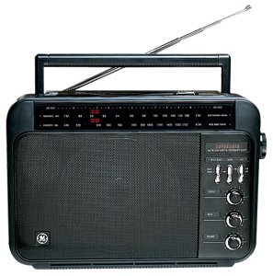
Low Resolution/High resolution?
Notes:
Just like an FM radio has a band that goes from 88 MHz to 108 MHz, the 20 Meter receiver has a band too. It goes from 1300 MHz to 1800 MHz!. You can tune the 20 meter telescope to specific frequencies to pick up signals from different elements or molecules. That’s High resolution observing. But you can also detect ALL of the signals across the whole band. Imagine picking up all of the stations on your FM radio at once. You could point your antenna around and more easily determine the total power from radio stations as a function of LOCATION.

Slide 5
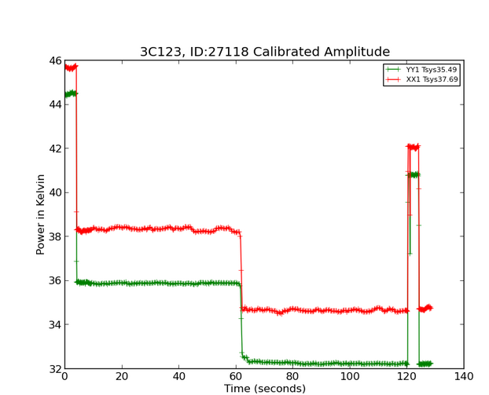
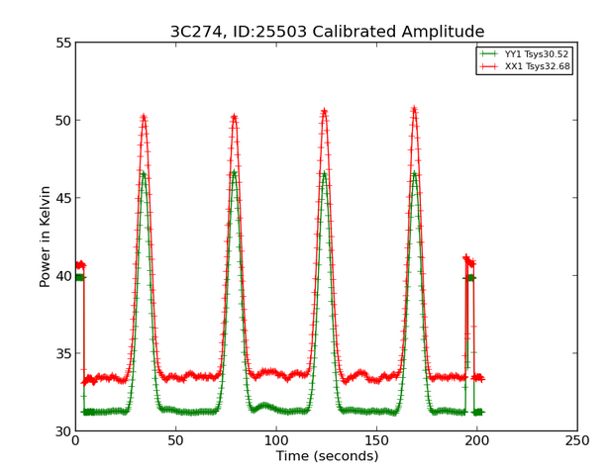
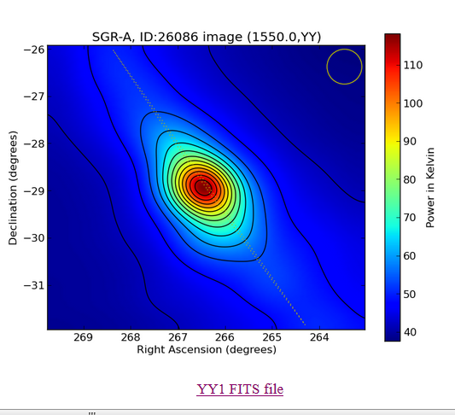
Sky Pattern | Spectral resolution | Why? | Example
On-off | Low and high | Good for measuring intensity of your object. Can add multiples together in hi-res mode to look for extragalactic hydrogen
Daisy | Low | Traces a flower-petal pattern. Good for measuring the strength of a source.
Map | Low | Good for making an image of an area of sky. Must be several degrees on a side! EG: Nebulae, galactic plane
Track | High | good for observing spectra in high-resolution mode
https://goo.gl/bryIdj

Slide 6
Data Products
currently not integrated with Skynet, but are archived at the Green Bank Observatory:
Radio Observing
Click on ID
Link to observatory url
Notes:
20 Meter Data are not stored on the Skynet computers just yet, and you can’t use Afterglow. But you can access the data on an NRAO website. This website also has much helpful advice! https://www.gb.nrao.edu/20m You get lots of data products: 2D graphs, Ascii Data, and Fits files that you can open with free programs like Astroimage processor, FITSVIEW, or DS9

Slide 7
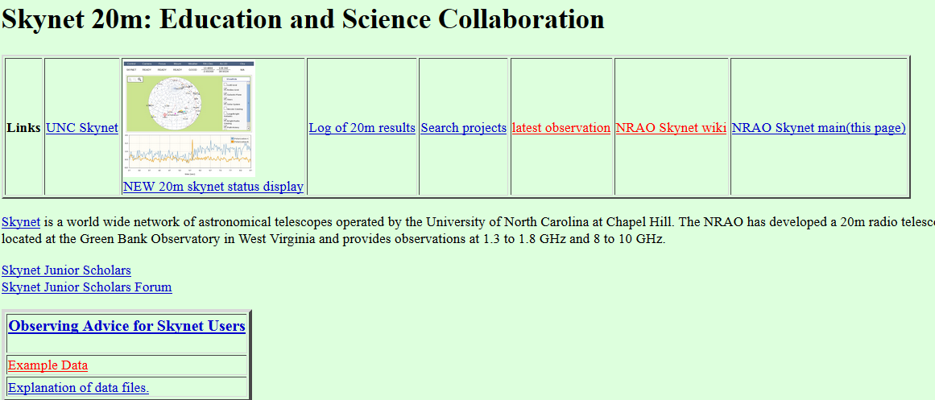
Searching the Archive Getting Advice
http://www.gb.nrao.edu/20m/

Slide 8
High Resolution
Looking for atomic and molecular transitions (spectral lines)
Atomic Hydrogen and Hydroxyl can be observed with the 20 Meter.
Notes:
You could do the spectrum tubes and diffraction gratings activity here.

Slide 9
Gas Spectra
Neon
Sodium
434 nm
486 nm
656 nm
Hydrogen
Notes:
Bottom one is hydrogen. Lines are produced as electrons jump from higher energy levels to lower ones. Energy released in the form of specific wavelengths or colors of light.

Slide 10
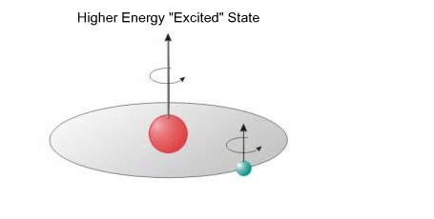
Hydrogen Atoms
Electron accelerates to a lower energy state
0.21 meters =1420.41MHz
Notes:
We also get radio spectral lines from hydrogen. This is called a spin flip transition. The atom has less energy after the electron flips – the energy equivalent to a 21 cm radio wave, with a frequency of 1420.41 MHz

Slide 11
You and your colleagues are from the Galactic Structure Scientific Institute. You have received observing time on the 20 Meter Telescope in order to investigate the Milky Way Galaxy in hydrogen atoms. Select 10 observing locations. Try some locations on and and away from the galaxy’s equator
Questions to guide you:
Do you see red and blue shifted lines in your spectral line data?
How do the data from different parts of the plane compare?
What can you infer from these data?
Can you determine what type of galaxy we live in?

Slide 12
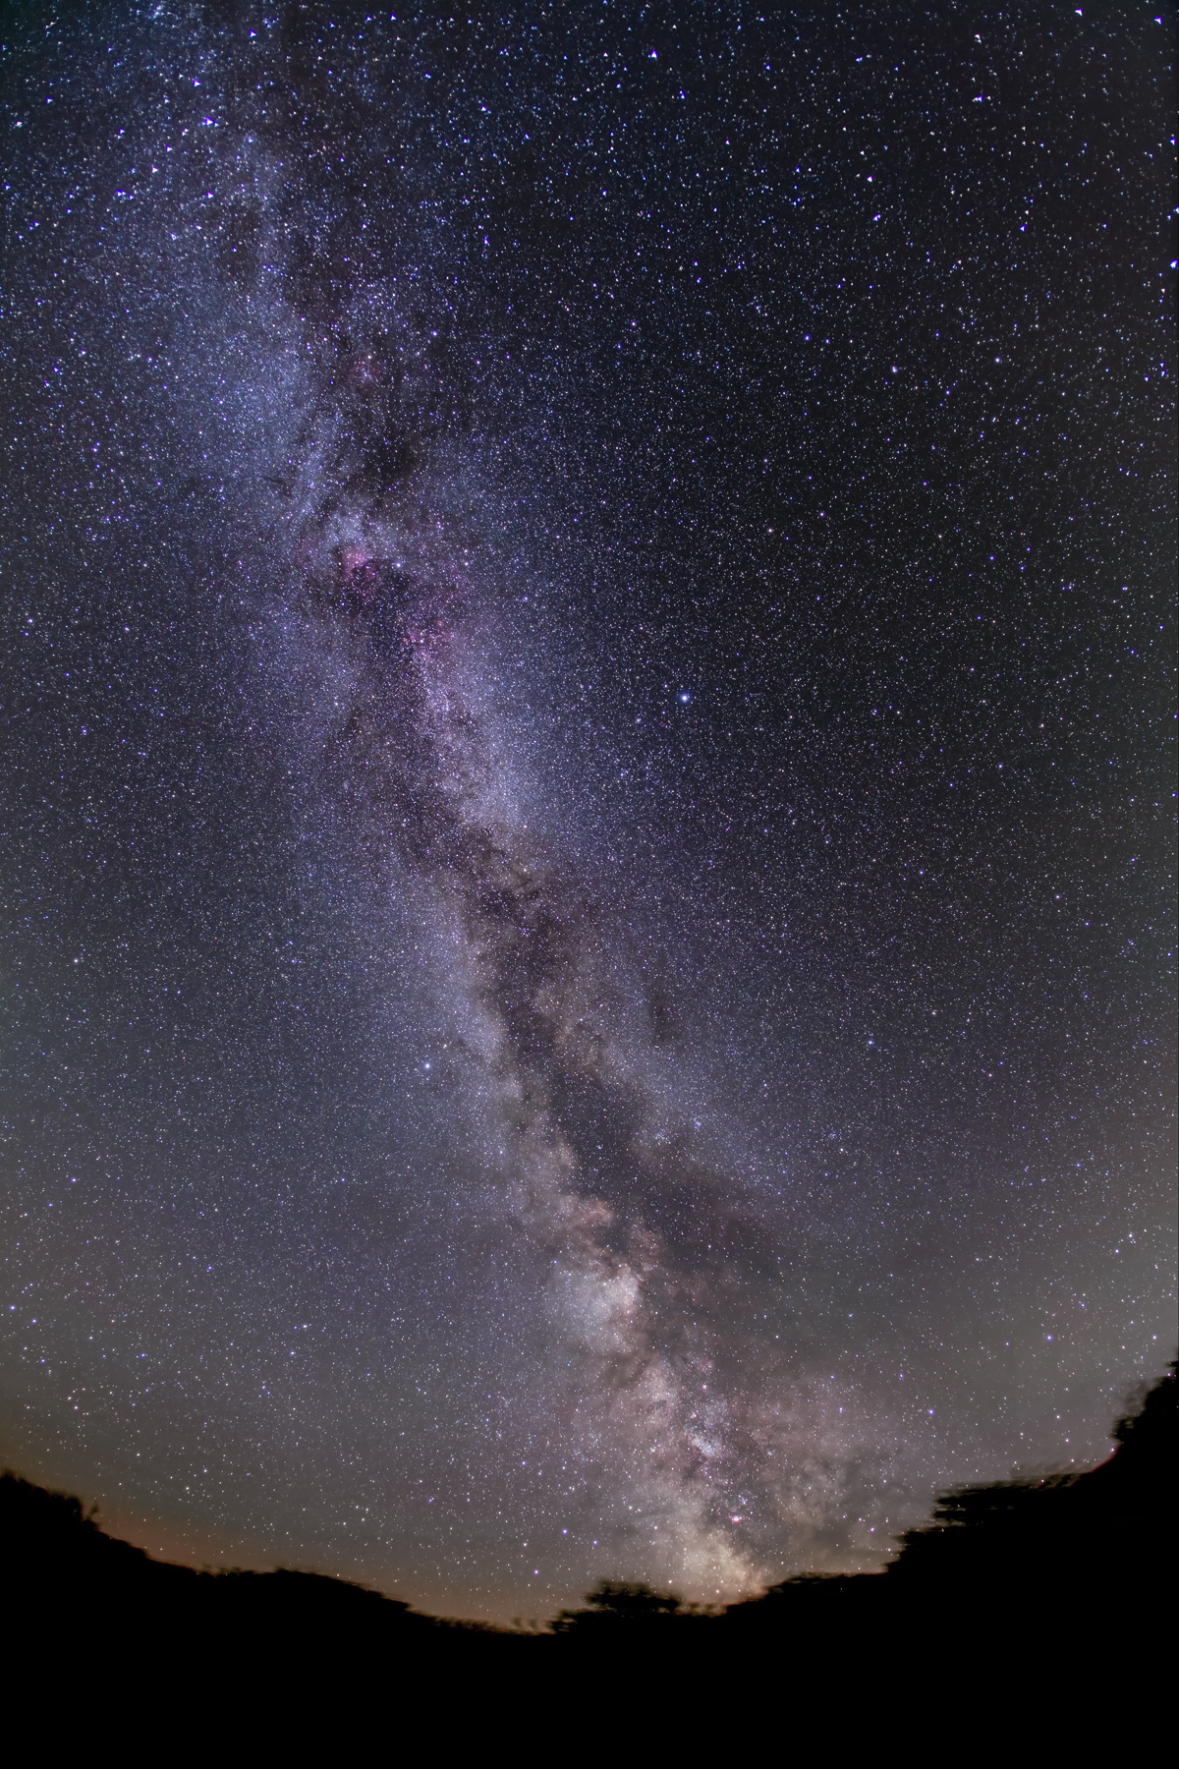
Notes:
Where will you look for atomic hydrogen signals? Perhaps the plane of the Milky Way?

Slide 13
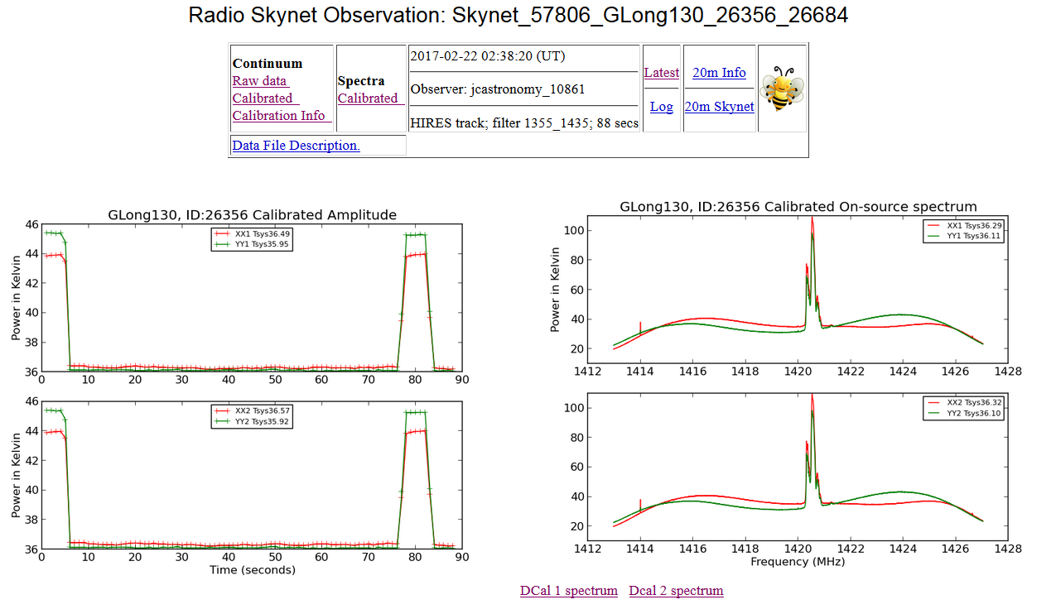
Notes:
20 Meter Quick Look Data. To zoom in on these spectral lines, import the ascii data into excel.

Slide 14
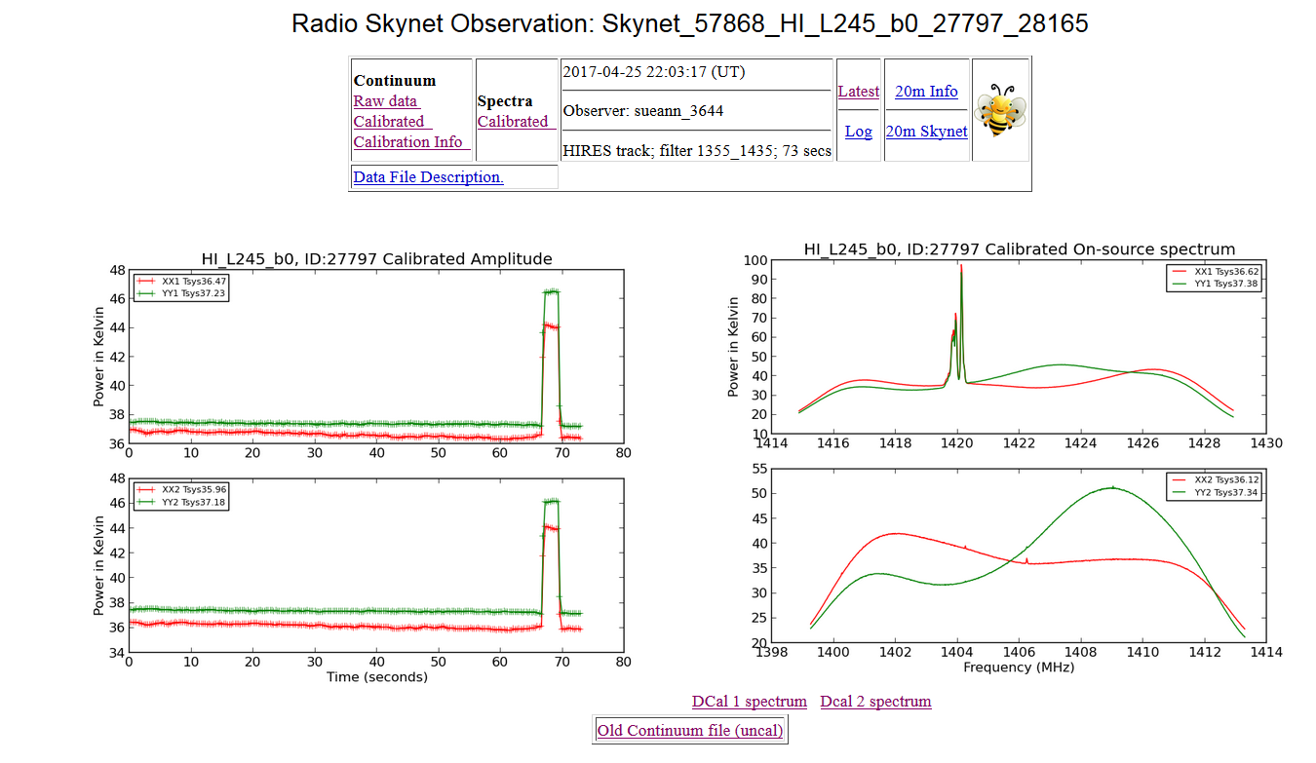

Slide 15
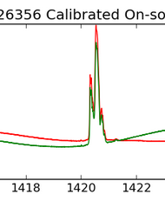
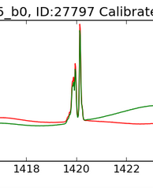
L=245
L=130
1420.4 MHz

